Slide 1
Heavy flavors and exotic hadrons
Lecture 1
Shigehiro YASUI
Tokyo Institute of Technology
53th Karpacz Winter School of Theoretical Physics and THOR COST Action Training School
@Karpacz, Poland 26 Feb. – 4 Mar. 2017

Slide 2

Japan

Slide 3

Japan
Tokyo Institute of Technology

Slide 4
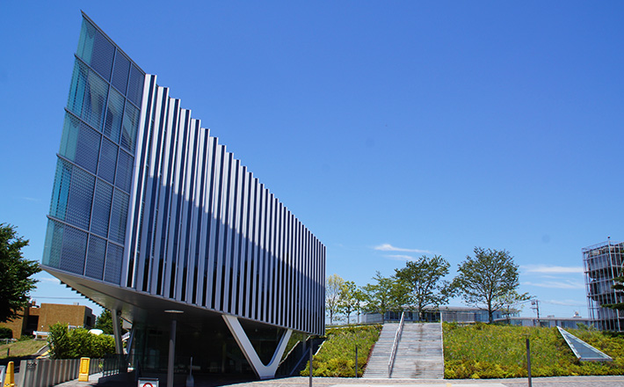
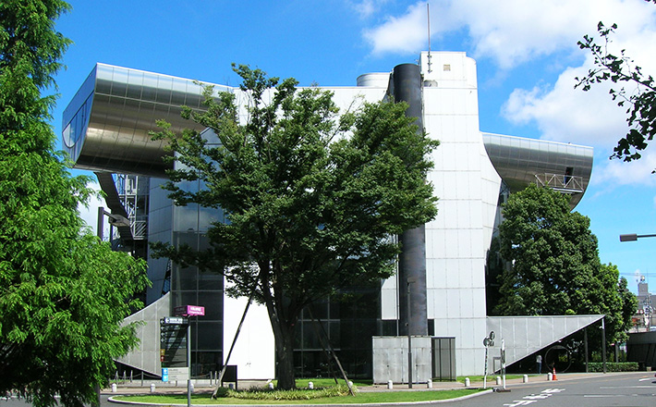
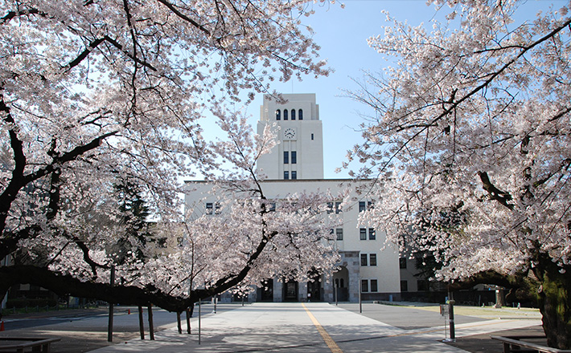
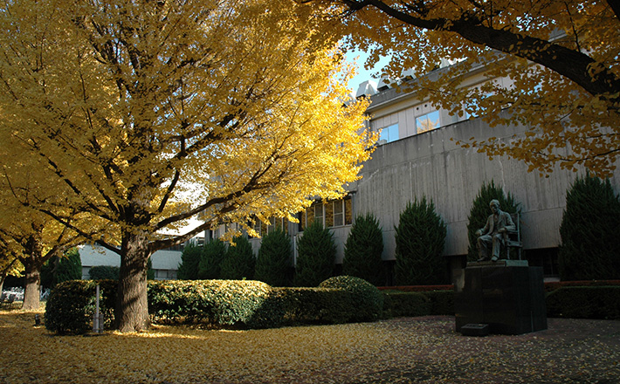
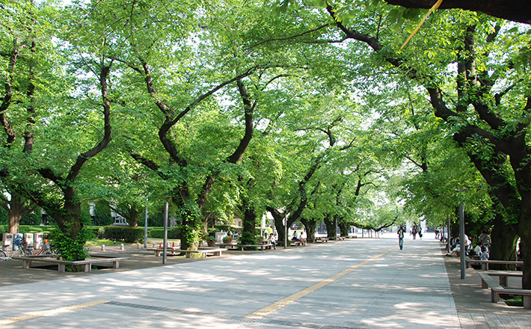
Cafeteria
Library
Photos of Tokyo Tech
↓Museum

Slide 5
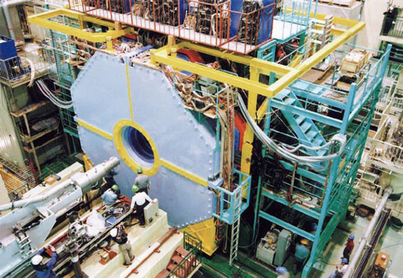
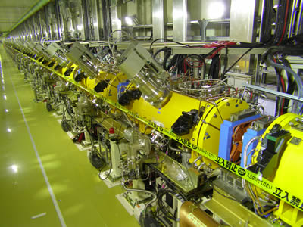
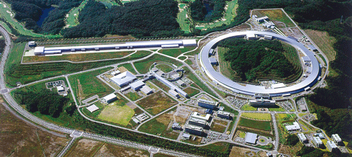
Japan
KEK (BelleI&II)
J-PARC
(Japan Proton Accelerator Research Complex )
Tokyo Institute of Technology
S-Pring 8
(Super Photon ring-8 GeV)

Slide 6
Content
1. Introduction
2. Theoretical framework for heavy hadrons
2.1 Heavy quark symmetry
2.2 Heavy hadron effective theory
3. Heavy exotic hadrons -X, Y, Z hadrons-
3.1 What does “exotic” mean?
3.2 X(3872)
3.3 Y(4260)
3.4 Z_{c}(3900)
3.5 Z_{b}(10610) and Z_{b}(10650)
3.6 P_{c}(4380) and P_{c}(4450): charm pentaquark
3.7 T_{cc} -new possible exotic hadrons-
3.8 Brief summary
4. Heavy hadrons at extreme conditions
4.1 Productions in relativistic heavy ion collisions
4.2 Properties of heavy hadrons in nuclear matter
5. Summary

Slide 7
References
(reviews)
Exotic heavy hadrons
・ The new heavy mesons: A status report:
E. S. Swanson, Phys. Rep. 429, 243 (2006)
・ Charmonium:
M. B. Voloshin, Prog. Part. Nucl. Phys. 61, 455 (2008)
・ Heavy quarkonium: progress, puzzles, and opportunities:
N. Brambilla et al., Eur. Phys. J. C71, 1534 (2011)
・ QCD and strongly coupled gauge theories: challenges and future perspectives:
N. Brambilla et al., Eur. Phys. J. C74, 2981 (2014)
・ The hidden charm pentaquark and tetraquark states:
H.-X Chen, W. Chen, X. Liu, S.-L. Zhu, Phys. Rep. 639, 1 (2016)
・ Exotic hadrons with heavy flavors: X, Y, Z, and relates states:
A. Hosaka, T. Iijima, K. Miyabayashi, Y. Sakai, S. Yasui, PTEP 2016, 062C01 (2016)
・ Heavy-Quark QCD Exotica:
R. F. Lebed, R. E. Mitchel, E. S. Swanson, arXiv:1610.04528 [hep-ph]
・ Multiquark resonances:
A. Esposito, A. Pilloni, A. D. Plolsa, Phys. Rep. 668, 1 (2017)
Exotic hadrons from heavy ion collisions
・ Exotic hadrons from heavy ion collisions:
S. Cho et al. [ExHIC collaboration], arXiv:1702.00486 [nucl-th]
Heavy hadrons in nuclear matter
・ Heavy hadrons in nuclear matter:
A. Hosaka, T. Hyodo, K. Sudoh, Y. Yamaguchi, S. Yasui, arXiv:1606.08685 [hep-ph]

Slide 9
Content
1. Introduction
2. Theoretical framework for heavy hadrons
2.1 Heavy quark symmetry
2.2 Heavy hadron effective theory
3. Heavy exotic hadrons -X, Y, Z hadrons-
3.1 What does “exotic” mean?
3.2 X(3872)
3.3 Y(4260)
3.4 Z_{c}(3900)
3.5 Z_{b}(10610) and Z_{b}(10650)
3.6 P_{c}(4380) and P_{c}(4450): charm pentaquark
3.7 T_{cc} -new possible exotic hadrons-
3.8 Brief summary
4. Heavy hadrons at extreme conditions
4.1 Productions in relativistic heavy ion collisions
4.2 Properties of heavy hadrons in nuclear matter
5. Summary

Slide 10
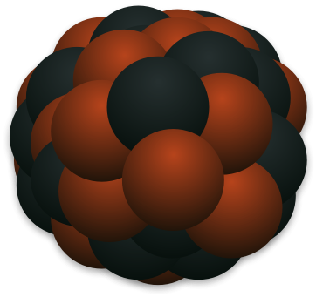

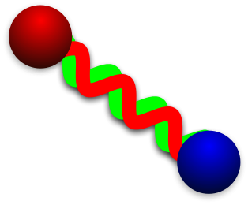
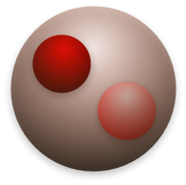
1. Introduction
From nucleus to quark
1 MeV = 10⁶ eV
1 GeV = 10⁹ eV
Condensed matter, Chemistry, Biology
〜10⁴ K
Plasma
Nuclear & Hadron
Elementary Particle
1 μeV
1 meV
1 eV
1 keV
1 MeV
1 GeV
1 TeV
〜 100 keV
surface vibration/rotation
〜 100 MeV
excited hadron
〜 100 GeV
quark
Nucleus
Hadron
proton/neutron
(baryon)
Quark
pion
(meson)
Gluon
Quark

Slide 11
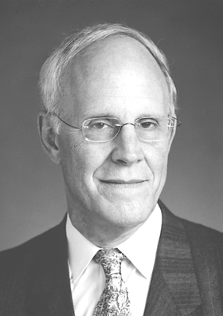
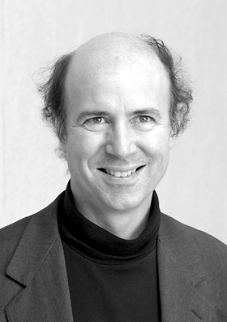

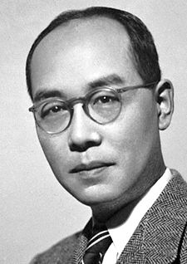
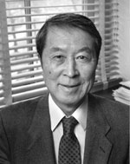
1. Introduction
From nucleus to quark
1 MeV = 10⁶ eV
1 GeV = 10⁹ eV
Condensed matter, Chemistry, Biology
〜10⁴ K
Plasma
Nuclear & Hadron
Elementary Particle
1 μeV
1 meV
1 eV
1 keV
1 MeV
1 GeV
1 TeV
〜 100 keV
surface vibration/rotation
〜 100 MeV
excited hadron
〜 100 GeV
quark
D. Gross
(1941-)
F. Wilczek
(1951-)
H. D. Politzer
(1949-)
Nucleus
Hadron
Superfluidity/Superconductivity
proton/neutron
(baryon)
Asymptotic freedom
Quark
Rotational symmetry
pion
(meson)
Color confinement
Gluon
Meson exchange
(Yukawa theory)
Chiral symmetry breaking
Quark
H. Yukawa
(1907-1981)
Y. Nambu
(1921-2015)
There is “physics” behind a variety of phenomena.
Can we understand nucleus/hadron by quarks and gluons?

Slide 12
Modern view of Nature
2. Fundamental properties of QCD
Matter and Field
Newton equation od motion
ma = F

Slide 13
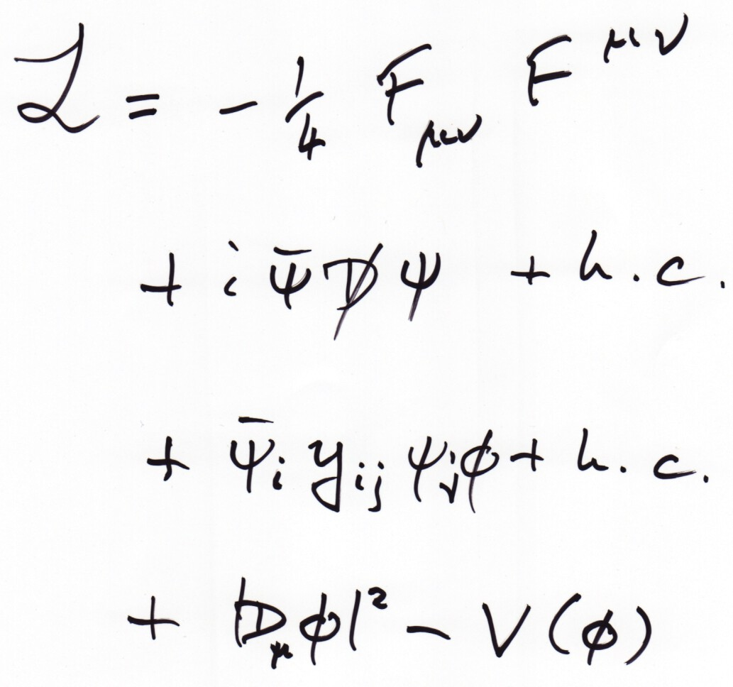
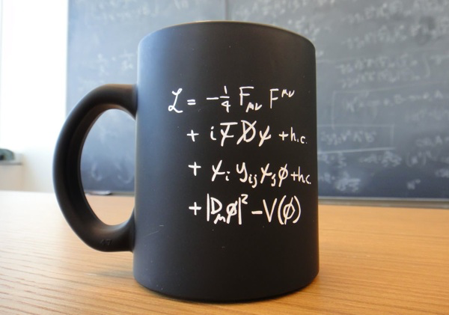
2. Fundamental properties of QCD
Basic laws of fundamental particles
Force (gauge field)
Matter (fermion field)
Fermion Mass (coupling to Higgs)
Origin of Mass (Higgs)

Slide 14


1. Introduction
Questions
・How do quarks compose hadrons?
quarks
hadrons
・What is the effective way to investigate
quark structure of hadrons?

Slide 15



1. Introduction
How do quarks move?
ma = F
Gluon
gluon
quark
quark
HiggsTan.com
gluon

Slide 16
1. Introduction
“Law of motion” of quarks and gluons
Quantum Chromodynamics
(QCD)
ψ_{f}: quark field (flavor f)
A_{μ}(F): gluon field
g_{s}: coupling between
quarks and gluons

Slide 17
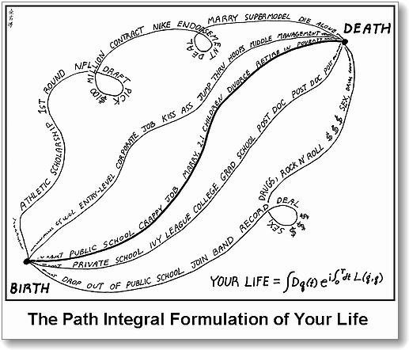
1. Introduction
“Law of motion” of quarks and gluons
?
Summation over all the possible values of ψ_{f} and A_{μ} from initial to final states.
free quarks
Confined quarks

Slide 18
1. Introduction
Why is hadron physics difficult?
Answer: strong coupling in low energy
Break-down of
perturbation
Quarks are “visible”.
Confined quarks
Perturbation is applicable.
(asymptotic freedom)
Hadron Physics
(Quarks are NOT visible.)
free quarks
0.01
0.1
(=10 MeV)
(=100 MeV)
Non-perturative effects in low energy.
Origin of a variety of matter states?

Slide 19
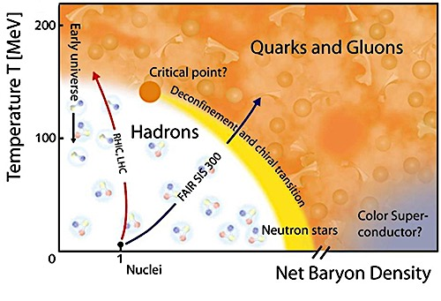

1. Introduction
Fundamental 4 Questions in Hadron Physics
① Why are quarks confined?
② What is hadron interaction?
QCD
Confined quarks
Nuclear force
③ Why is chiral symmetry broken?
④ What is phase diagram?

Slide 20
1. Introduction
Properties of QCD
① Color charge (red, blue, green)

Slide 21
1. Introduction
Color charge (review)
QED
QCD
U(1) symmetry
SU(3) symmetry
T₈
quark q
electron e⁻
T₃
-e
“Minus sign”
T₈
positron e⁺
antiquark q
T₃
+e

Slide 22
1. Introduction
Color charge (review)
Hadrons are colorless (white: T₃=T₈=0)
meson (qq)
baryon (qqq)
+
+

Slide 23
1. Introduction
Properties of QCD
① Color charge (red, blue, green)
② Gluon exchange in inter-quark
Time
gluon
quark
proton
neutron
proton
neutron

Slide 24
1. Introduction
Properties of QCD
① Color charge (red, blue, green)
② Gluon exchange in inter-quark
③ Asymptotic freedom (small coupling at high energy)
④ “Structure” of QCD vacuum
- quarks are confined
- chiral symmetry is broken
“Wonderland” of strong interaction!!

Slide 25

1. Introduction
“Structure” of QCD vacuum?
Many particles in QCD vacuum!
HiggsTan.com
”Non-perturbative vacuum”
(Condensate by interaction is realized by stability of energy.)

Slide 26
1. Introduction
“Structure” of QCD vacuum?
Many particles in QCD vacuum!
HiggsTan.com
”Non-perturbative vacuum”
(Condensate by interaction is realized by stability of energy.)

Slide 27
1. Introduction
“Structure” of QCD vacuum?
Many particles in QCD vacuum!
HiggsTan.com
”Non-perturbative vacuum”
(Condensate by interaction is realized by stability of energy.)

Slide 28
1. Introduction
“Structure” of QCD vacuum?
What happens in QCD vacuum?
“Dynamical breaking of chiral symmetry”

Slide 29
1. Introduction
“Structure” of QCD vacuum?
What happens in QCD vacuum?
“Dynamical breaking of chiral symmetry”
Empty space
Speed of light
〜 0 MeV
Chiral symmetry restored

Slide 30
1. Introduction
“Structure” of QCD vacuum?
What happens in QCD vacuum?
“Dynamical breaking of chiral symmetry”
Empty space
QCD vacuum
Less than speed of light
Speed of light
〜 0 MeV
〜 300-400 MeV
Chiral symmetry restored
Chiral symmetry broken
Chiral symmetry is broken dynamically by interaction.

Slide 31
1. Introduction
Nambu-Jona-Lasinio model (3 min. review)
① NJL Lagrangian
② Chiral symmetry
U(1)_{V}:
U(1)_{A}:
NJL Lagrangian is invariant under chiral symmetry.
③ Mean-field approximation
④ Generation of dynamical mass of fermion
Finite mass breaks U(1)_{A} symmetry
→ Chiral symmetry breaking in ground state
Review papers:
U. Vogl, W. Weise, Prog. Part. Nucl. Phys. 27, 195 (1991)
S. P. Kulevansky, Rev. Mod. Phys. 64, 649 (1992)
T. Hatsuda, T. Kunihiro, Phys. Rep. 247, 221 (1994)
⑤ Solving gap equation
→ m〜 300-400 MeV

Slide 32
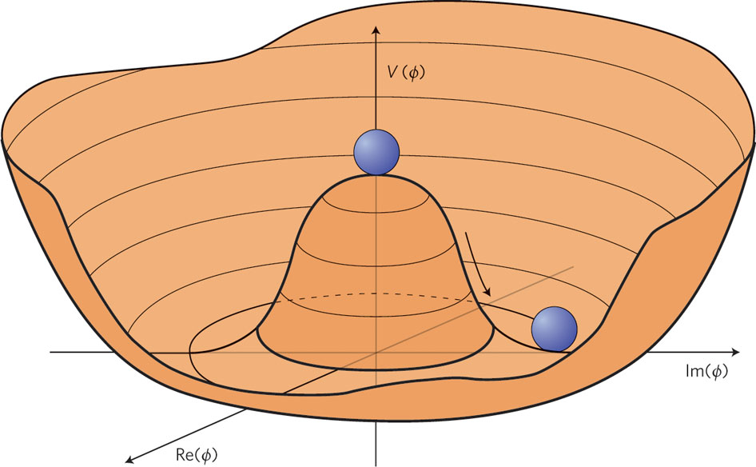
1. Introduction
“Structure” of QCD vacuum?
What happens in QCD vacuum?
Zero-mass boson exists
in vacuum with dynamically
broken symmetry
(Nambu-Goldstone (NG) boson)
Origin of light pion mass!
(m_{π}=140 MeV << m_{N}=940 MeV)
π
L. Álvarez-Gaumé, J. Ellis, Nature Physics 7, 2–3 (2011)

Slide 33
1. Introduction
“Structure” of QCD vacuum?
What happens in QCD vacuum?
Zero-mass boson exists
in vacuum with dynamically
broken symmetry
(Nambu-Goldstone (NG) boson)
Origin of light pion mass!
(m_{π}=140 MeV << m_{N}=940 MeV)
〜1fm
〜1fm
1/m_{π}〜1.5fm
Exchange of
virtual π(qq)
Inter-hadron
interaction
Hadron (proton)
Hadron (neutron)
π exchange interaction is dominant at long distance.

Slide 34
1. Introduction
Main subject in this lecture:
Formation mechanism of hadrons by quarks
HADRON

Slide 35
1. Introduction
Quark
Anti-Quark
2

Slide 36
1. Introduction
Quark
Quark
Quark
3

Slide 37
1. Introduction
Quark
Anti-Quark
Quark
Anti-Quark
4

Slide 38
1. Introduction
Quark
Anti-Quark
5
Quark
Quark
Quark

Slide 39
1. Introduction
Quark
Quark
Quark
Quark
Quark
Quark
6

Slide 40
1. Introduction
To be continued

Slide 41
1. Introduction
Variety of Hadrons
2
3
4
5
6

Slide 42
1. Introduction
Variety of Hadrons
meson
baryon
tetraquark
pentaquark
hexaquark

Slide 43
1. Introduction
Quiz: how many hadrons were discovered?
about 3
about 30
about 300
①
②
③
proton,
neutron,
pion,
that’s all!
I may have seen
Δ, ω, ρ, etc. somewhere...
Do we need
so many hadrons?

Slide 44
1. Introduction
about 300
Table of hadrons
Particle Data Group

Slide 45



1. Introduction
Flavors
HiggsTan.com
electric
charge
1st
2nd
3rd
up
charm
top
Q=+2/3
2 MeV
1300 MeV
173000 MeV
down
strange
bottom
Q=-1/3
5 MeV
100 MeV
4200 MeV

Slide 46
1. Introduction
Flavors
HiggsTan.com
electric
charge
1st
2nd
3rd
up
charm
top
Q=+2/3
2 MeV
1300 MeV
173000 MeV
down
strange
bottom
Q=-1/3
5 MeV
100 MeV
4200 MeV

Slide 47

Question?

